Slide 1
IEEE ORIENTATION SEMINAR

Slide 2
What is IEEE?
IEEE stands for the Institute of Electrical and Electronics Engineers.
IEEE is the world’s largest professional association dedicated to advancing technological innovation and excellence for the benefit of humanity.
IEEE and its members inspire a global community through IEEE's highly cited publications, conferences, technology standards, and professional and educational activities.

Slide 3
IEEE STANDARDS
Develops global standards in a broad range of industries .
IEEE-SA is not a body formally authorized by any government, but rather a community.
Technical experts from all over the world participate in the development of IEEE standards .

Slide 4
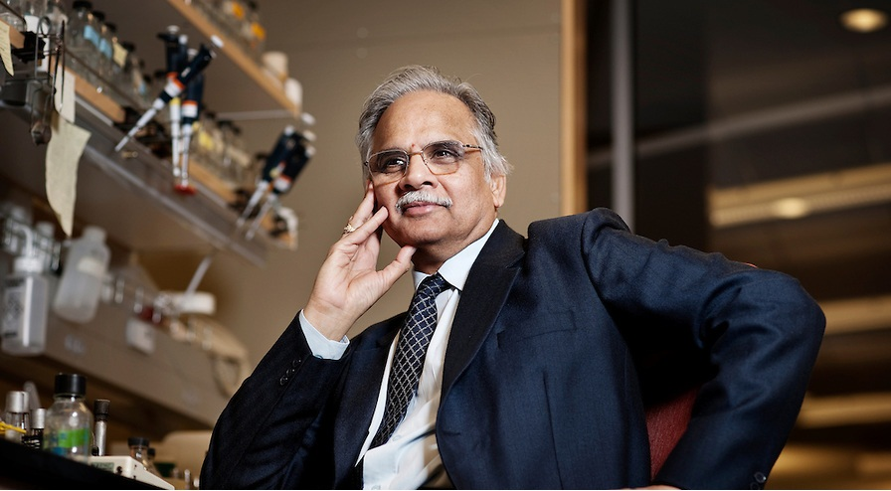
FAMOUS PERSONALITIES
Dr. Mathukumalli Vidyasagar Head, Bioengineering Dept , University of Texas Chair , IEEE Life Sciences Committee
“ I have been an IEEE member since I was a student in 1969. Today , IEEE’s great tools can spread boundaries of knowledge , bridge the geographic gap and help make other countries feel part of the global community “

Slide 5
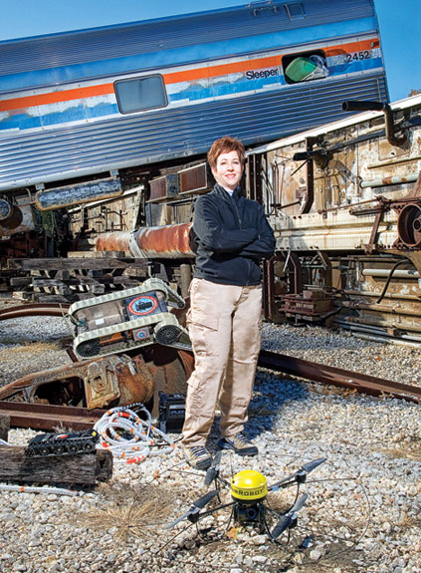
Dr. Robin Murphy Machines and Automation Expert
“ Since I began as an IEEE member , I’ve subscribed to many journals and used digital libraries .IEEE Robotics and Automation Society have been really positive in terms of trying to engage women “

Slide 6
HOW TO BECOME AN IEEE MEMBER
Student Membership Fees : 27$
You can join IEEE by completing the online membership available on www.ieee.org/join .
You can also become a member by contacting Student Branch at our college.
Offline Payment Mode : Demand Draft

Slide 7
BEnefits of IEEE
Awards, Scholarships, And Fellowships:
IEEE offers a variety of awards, scholarships, and fellowships for IEEE student members. Submit a project or paper for consideration and have the opportunity to win and gain peer recognition for your effort.
IEEE Spectrum Magazine:
Spectrum explores career strategies, the latest in research, and important technical developments. Through its articles, it also relates theories to practical applications, highlights technology’s global impact, and generates international forums that foster the sharing of diverse ideas about the profession.

Slide 8


Slide 9


Slide 10


Slide 11


Slide 12
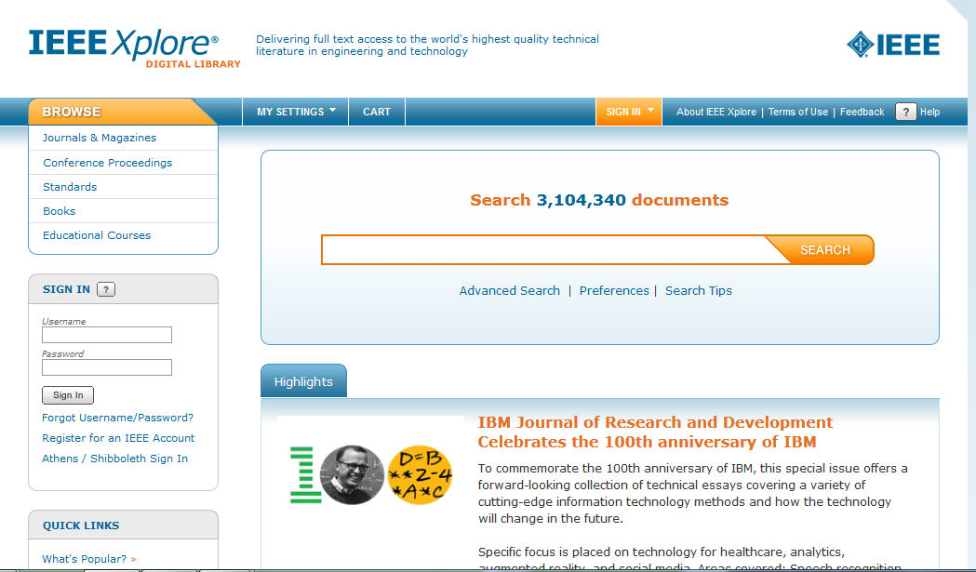

Slide 13


Slide 14


Slide 15
BEnefits of IEEE
Knowledge:
IEEE members gain exclusive access to the latest and best research, news, television programs, and educational resources needed to expand their expertise and stay current.
Community:
As an IEEE member, you are part of the world’s largest community of technology professionals—a network of communication and learning where innovators share what works, what does not, and what is needed now.
Being an IEEE Member entitles you to a discount in all IEEE activities in all colleges .

Slide 16


Slide 17


Slide 18
IEEE SOCIETIES
Aerospace and Electronic
Computer
Circuits And Systems
Communication
Power Electronics
Information Theory
Nuclear Sciences
Geoscience
Vehicular Technology
Power And Energy
Reliability
Consumer Electronics

Slide 19
WHY 27$...?
Global Exposure
Hands on Experience
Availability to abundant resources , libraries , articles , journals from all around the world
Professional and Educational development

Slide 20
video

Slide 21
PREVIOUS YEAR’S ACTIVITIES
IEEE DAY
WORKSHOP WIRED ROBOTICS
IEEE 360 DEGREES
CONFERENCES
COLLABORATIVE COLLEGE EVENTS
XZIBIT(State Level Project Competition)

Slide 22
ACTIVITIES PLANNED
Engineers Day Celebration
IEEE Week -Technical Quiz, Article Writing, Blood donation , Seminars,GD,PI
Workshops – Ethical Hacking ,Web Development , IOS Development, Wired Robotics and Electrobotics
Industrial Visit
Technical Fest – Detriox , IEEE 360 Degrees
State Level Project Competition

Slide 23
IEEE KCCOE COUNCIL 2012-13
Executive Committee
Branch Counselor - Amarja Adgaonkar Mam
Interim Chair - Jekin Dedhia
Vice Chair - Sachin Thakur
Secretary - Siddharth Sharma
Treasurer - Gurpreet Singh
Editing Head - Kaustabh Phani
Web Master - Omkar Bhagat

Slide 24
Technical Committee Technical Head – Jaspreet Singh R & D officers – Anchit Srivastava , Robin George, Saurabh Motewar
Publicity and Member Committee Public Relation Officer – Sneha Yadav Publicity Head - Rohit Shete Creative Heads - Sagar Save, Siddharth Valluvan Membership Development Officer – Sagar Zambre
Operations Committee Chief Operation Officer - Harvinder Singh Amar Industrial Visit Coordinator - Gaurav Singbal

Slide 25
IEEE KCCOE 2013-14 COUNCIL STRUCTURE
Chairperson
Secretary
Editor
Sponsorship head
Workshop Coordinator
Web Master
Infrastructure and Inventory head
Vice Chairperson
Treasurer
Public Relation Officer
Chief Operation Officer
Research And Development Head
Assistant Web Master
Industrial Visit Co-ordinator

Slide 26


Slide 27



WEBSITE
www.ieee-kccoe.org
Join our facebook group IEEE KCCOE Facebook page: https://www.facebook.com/official.ieee.kccoe
IEEE360DEG : https://www.facebook.com/Ieee360DegreesKccoe

Slide 28
THANK YOU

